Slide 1
INTERNITY FOUNDATION
PRESENTATION ON LINKED LIST
Presented by:
Lipika Chugh
Rajat Kapoor
Aman Goyal

Slide 2




Arrays Vs Linked Lists
Arrays | Linked list
Fixed size: Resizing is expensive | Dynamic size
Insertions and Deletions are inefficient: Elements are usually shifted | Insertions and Deletions are efficient: No shifting
Random access i.e., efficient indexing | No random access 🡪 Not suitable for operations requiring accessing elements by index such as sorting
No memory waste if the array is full or almost full; otherwise may result in much memory waste. | Since memory is allocated dynamically(acc. to our need) there is no waste of memory.
Sequential access is faster [Reason: Elements in contiguous memory locations] | Sequential access is slow [Reason: Elements not in contiguous memory locations]

Slide 3






Schematic representation
 Here is a singly-linked list (SLL):
myList
a
b
c
d
Each node contains a value(data) and a pointer to the next node in the list
myList is the header pointer which points at
the first node in the list

Slide 4

Insertion at the beginning
There are two steps to be followed:-
Make the next pointer of the node point towards the first node of the list
Make the start pointer point towards this new node
If the list is empty simply make the start pointer point towards the new node;

Slide 5

void insert_beg(node* new)
{
node* temp;
if(head==NULL)
{ head=new;
//if the list is empty
cout<<”\nNode inserted successfully at the beginning”;}
else {
temp=head; head=new;
new->next=temp; //making new node point at
the first node of the list
}
}

Slide 6
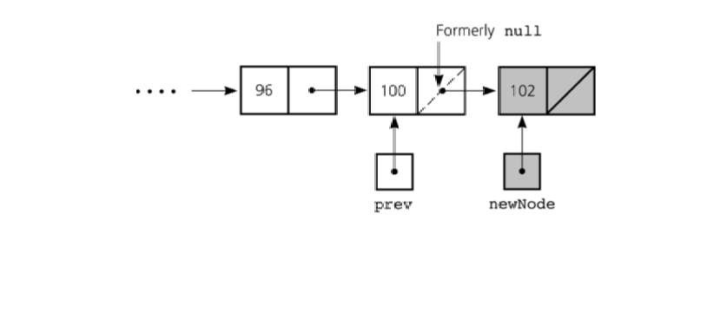
Inserting at the end
Here we simply need to make the next pointer of the last node point to the new node

Slide 7

void insert_end(node* new)
{
node *q=start;
if(start==NULL)
{
start=new;
cout<<”\nNode inserted successfully at the end…!!!\n”;
}
else{
while(q->last!=NULL) q=q->last;
q->next=new;
new->next=NULL;
}
}

Slide 8

Inserting after an element
Here we again need to do 2 steps :-
Make the next pointer of the node to be inserted point to the next node of the node after which you want to insert the node
Make the next pointer of the node after which the node is to be inserted, point to the node to be inserted

Slide 9

void insert_after(int c,node* new)
{
node* q; q=start;
for(int i=1;i<c;i++)
{
q=q->next;
if(q==NULL)
cout<<”Less than “<<c<<” nodes in the list…!!!”;
}
new->next=q->next; q->next=new;
cout<<”\nNode inserted successfully”;
}

Slide 10

Deleting a node in SLL
Here also we have three cases:-
Deleting the first node
Deleting the last node
Deleting the intermediate node

Slide 11



Deleting the first node
Here we apply 2 steps:-
Making the start pointer point towards the 2nd node
Deleting the first node using delete keyword
start
one
two
three

Slide 12

void del_first()
{
if(start==NULL) cout<<”\nError……List is empty\n”; else
{
node* temp=start; start=temp->link; delete temp;
cout<<”\nFirst node deleted successfully….!!!”;
}
}

Slide 13



Deleting the last node
Here we apply 2 steps:-
Making the second last node’s next pointer point to NULL
Deleting the last node via delete keyword
start
node1 node2 node3

Slide 14

void del_last()
{
if(start==NULL)
cout<<”\nError….List is empty”;
else{
node* q=start;
while(q->link->link!=NULL)
q=q->link;
node* temp=q->link;
q->link=NULL;
delete temp;
cout<<”\nDeleted successfully…”;
}
}
}

Slide 15

Deleting a particular node
Here we make the next pointer of the node previous to the node being deleted ,point to the successor node of the node to be deleted and then delete the node using delete keyword
node1 node2
node3
To be deleted

Slide 16

void del(int c)
{
node* q=start;
for(int i=2;i<c;i++)
{
q=q->link;
if(q==NULL)
cout<<”\nNode not found\n”;
}
if(i==c)
{
node* p=q->link; q->link=p->link; delete p;
//node to be deleted
//disconnecting the node p
cout<<“Deleted Successfully”;
}
}

Slide 17

Doubly Linked List
Doubly linked list is a linked data structure that consists of a set of sequentially linked records called nodes.
2 .
Each node contains three fields ::
-: one is data part which contain data only.
-: two other field is links part that are point or references to the previous or to the next node in the sequence of nodes.
3.
The beginning and ending nodes' previous and next links, respectively, point to some kind of terminator, typically a sentinel node or null to facilitate traversal of the list.

Slide 18

NODE
previous | data | next
A
B
C
NULL | 11 | 786
200
656
400
786 | 777 | NULL
200
786
400
A doubly linked list contain three fields: an integer value, the link to the next node, and the link to the previous node.

Slide 19
DLL’s compared to SLL’s
Advantages:
Can be traversed in either direction (may be essential for some programs)
Some operations, such as deletion and inserting before a node, become easier
Disadvantages:
Requires more space
List manipulations are slower (because more links must be changed)
Greater chance of having bugs (because more links must be manipulated)

Slide 20



Inserting at beginning

Slide 21

void insert_beg(node *p)
{
if(start==NULL)
{
start=p;
cout<<"\nNode inserted successfully at the beginning\m";
}
else
{
node* temp=start;
start=p;
temp->previous=p;
p->next=temp;
cout<<"\nNode inserted successfully at the beginning\n";
}

Slide 22

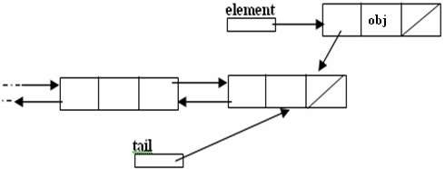
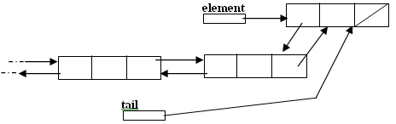
Inserting at the end

Slide 23

void insert_end(node* p)
{
if(start==NULL)
{
start=p;
cout<<"\nNode inserted successfully at the end";
}
else
{
node* temp=start;
while(temp->next!=NULL)
{
temp=temp->next;
}
temp->next=p;
p->previous=temp;
cout<<"\nNode inserted successfully at the end\n";
}
}

Slide 24

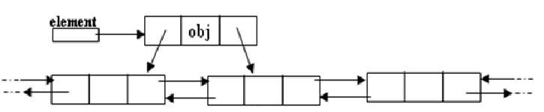
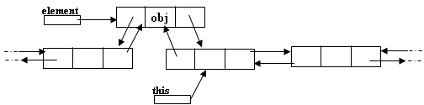
Inserting after a node
Making next and previous pointer of the node to be inserted point accordingly
Adjusting the next and previous pointers of the nodes b/w which the new node accordingly

Slide 25

void insert_after(int c,node* p)
{
temp=start;
for(int i=1;i<c-1;i++)
{
temp=temp->next;
}
p->next=temp->next;
temp->next->previous=p;
temp->next=p;
p->previous=temp;
cout<<"\nInserted successfully";
}

Slide 26



Deleting a node
Node deletion from a DLL involves changing two links
In this example,we will delete node b
myDLL
a
b c
We don’t have to do anything about the links in node b
Garbage collection will take care of deleted nodes
Deletion of the first node or the last node is a special case

Slide 27

void del_at(int c)
{
node*s=start;
{
for(int i=1;i<c-1;i++)
{
s=s->next;
}
node* p=s->next; s->next=p->next;
p->next->previous=s;
delete p;
cout<<"\nNode number "<<c<<" deleted successfully";
}
}
}

Slide 28

APPLICATIONS OF LINKED LIST
Undo functionality in Photoshop or Word (a linked list of state)
Image viewer – Previous and next images are linked, hence can be accessed by next and previous button.
Previous and next page in web browser – We can access previous and next url searched in web browser by pressing back and next button since, they are linked as linked list.
Music Player – Songs in music player are linked to previous and next song. you can play songs either from starting or ending of the list.

Slide 29


THANK YOU

